Slide 1
DE_DUST2 BRICKLAYER
DIEGO VAZQUEZ

Slide 2
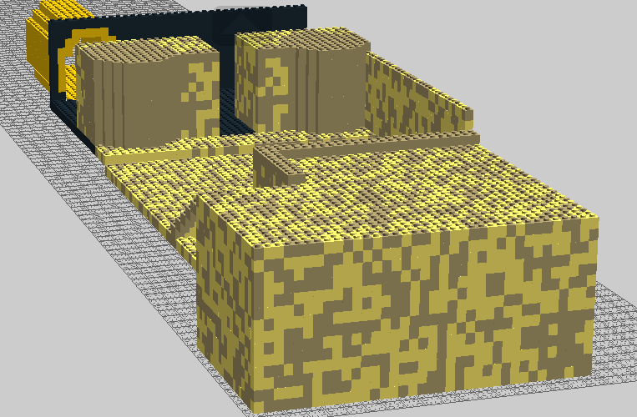
DE_DUST2 T SPAWN (B SIDE)

Slide 3
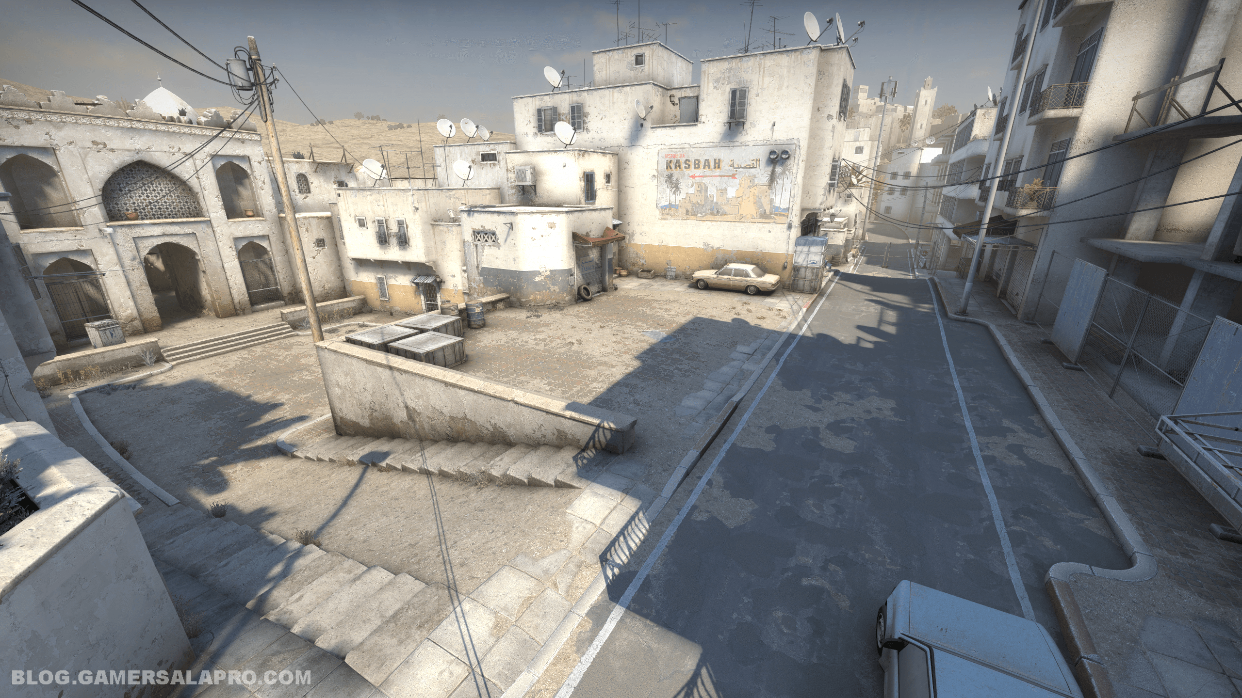
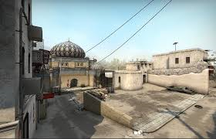

Slide 4
